Slide 1
CAPSTONE PROJECT-INSURANCE MANAGEMENT SYSTEM - Policy Microservice
Rojesh Maharjan

Slide 2
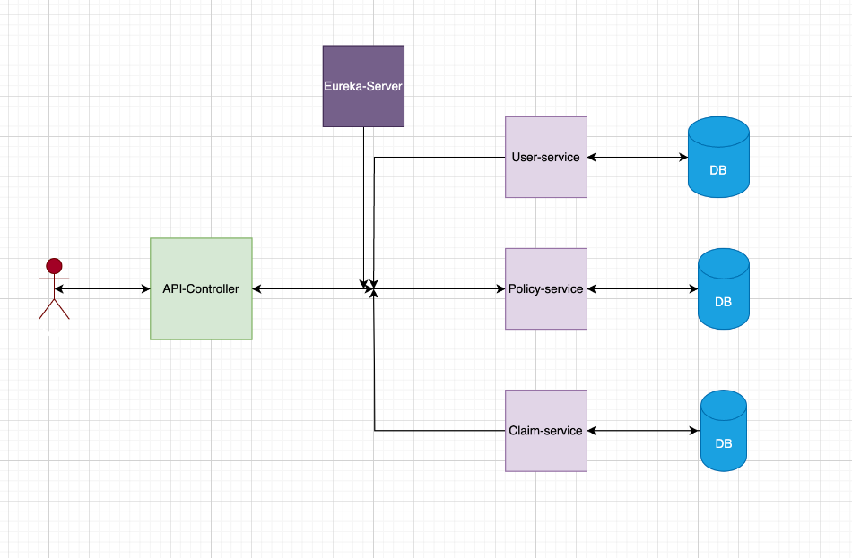
Architecture Design -IMS

Slide 3
Policy Management Microservice
Responsible for managing insurance policies
Functionalities: policy creation, updates, retrieval, listing
Communication with User Management Microservice

Slide 4
Policy Management Microservice
Entity Class
policyId (Primary Key): Unique identifier for each policy.
policyNumber: Unique policy number assigned to the policy.
policyHolderName: Name of the policyholder.
premiumAmount: Premium amount associated with the policy.
startDate: Effective start date of the policy.
endDate (Optional): Effective end date of the policy (null for ongoing policies).

Slide 5
Policy Management Microservice
Repository used: JPA Repository.
Service layer:
Policy createPolicy(Policy policy);
Policy getPolicyById(Integer policyID);
List<Policy> getAllPolicy();
Policy updatePolicy(Policy policy);
void deletePolicy(Integer policyId);

Slide 6
Policy Management Microservice –Rest Controller
Admin | User
Create policy | Can only view the policy.
Get the policy with policy ID
Get all the policies
Update the policies
Delete the policies

